Slide 1

Identifying Seattle’s disconnected streets (geo)(graphically)
Michael Babb
November 20, 2024

Slide 2
Overview
Motivating question
The data
The technique
Results

Slide 3
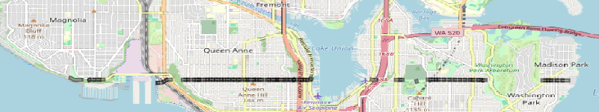
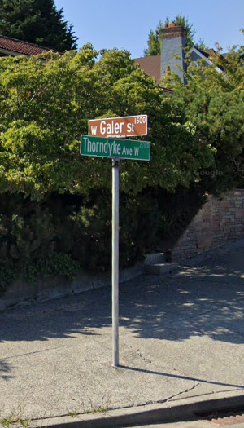
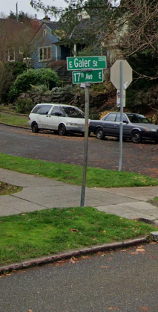
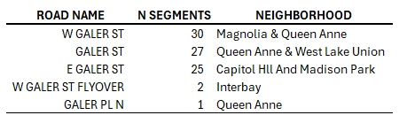
This street is in this Neighborhood?!
MAGNOLIA:
W GALER ST & THORNDYKE AVE W
CAPITOL HILL:
E GALER ST & 17TH AVE E

Slide 4
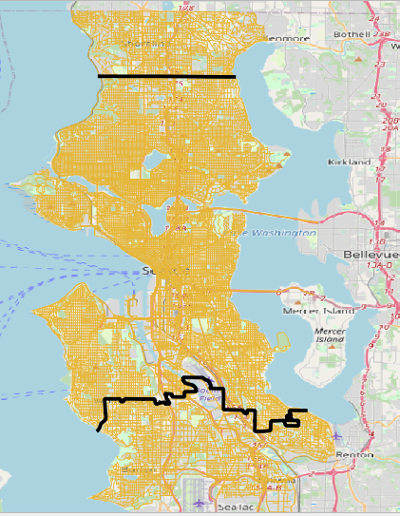
Input Data:
Seattle GeoData: 34,375 segments
(downloaded 2024/11/04)
Focus on roads in Seattle: 27,891 segments
Remove the following segment types:
alley, trail, overpass, interstate, rail-road,
flyover, streetcar, extension, turn,
highway ramps, walkways
2,497 unique roads featuring 26,881 segments
Unique roads include direction prefix / suffix
W GALER ST != GALER ST != E GALER ST

Slide 5
The technique
A combination of geospatial analysis AND graph analysis to connect disconnected street ends
Shapely, GeoPandas:
Data I/O
Compute the straight-line distance between two sets of coordinates
NetworkX:
nx.from_pandas_edgelist() to create an undirected graph (nodes are intersections, edges are roads)
nx.connected_components() to identify discontinuities in the graph (disconnected roads)
nx.non_edges() to compute the set of possible “missing edges” (many possible ways to connect disconnected street ends)
nx.k_edge_augmentation() to find the optimal missing edge (the path between disconnected street ends guaranteeing full graph traversal)

Slide 6
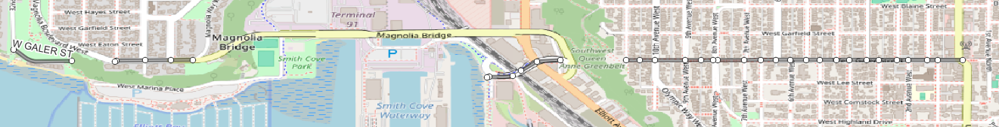

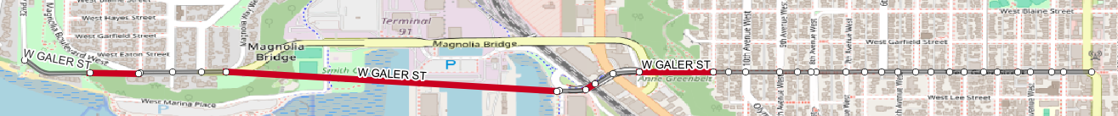
W GALER ST
As a road network…
5 sections
As a graph…
35 nodes | 30 edges
565 possible edges
347 optimized possible edges
…4 ideal segments can be added to connect W GALER ST

Slide 7
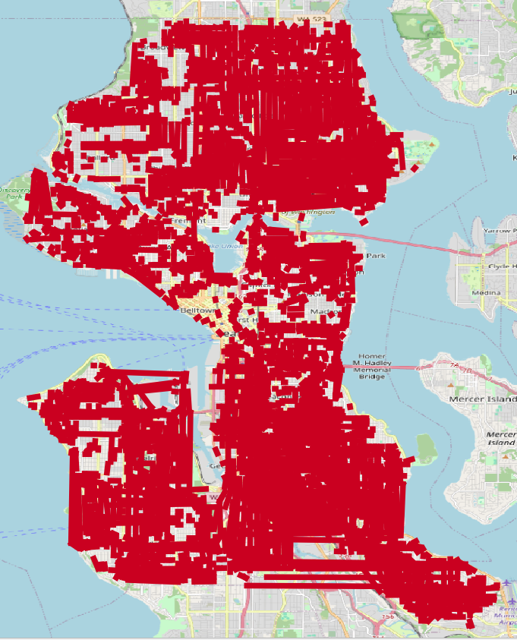
For all Roads…
2,497 roads in the study area| 1,933 road miles
1,357 roads without discontinuities | 421 road miles
1,140 roads with discontinuities | 1,512 road miles
3,643 segments added across 1,140 roads | 834 miles
Average of ~3.2 segments per road
Average segment length: ~0.23 Miles
Median segment length: ~443 Feet
Greatest number of segments added: 14
(1ST AVE NW, 30TH AVE S, 35TH AVE S, W RAYE ST)
Longest segment: ~5 Miles: 7Th PL S
Shortest segment: ~4 Feet: SW Cloverdale ST

Slide 8
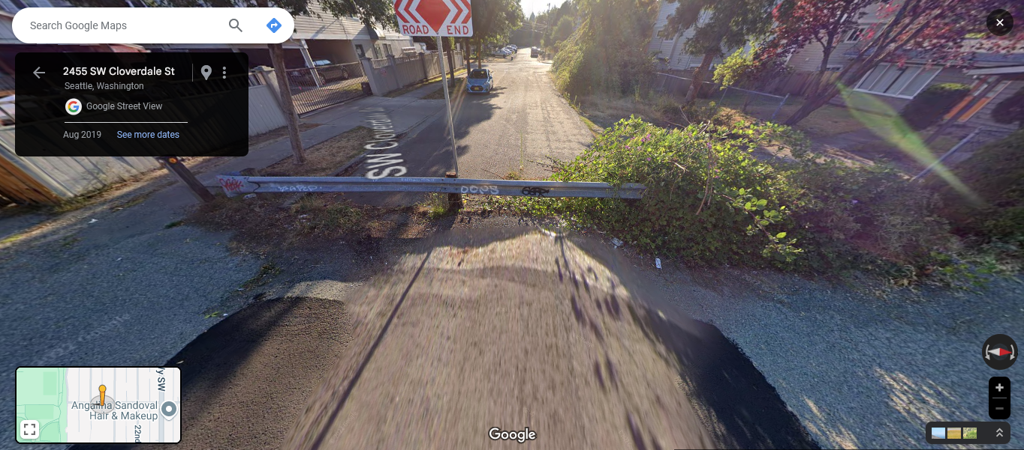
A four-foot missing segment?

Slide 9
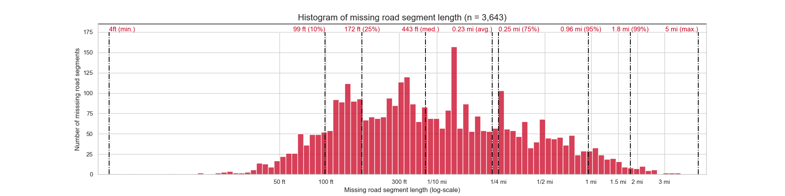
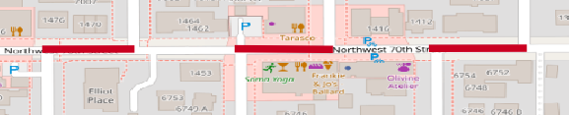
Most added segments are short!
Short runs due to grid non-alignment
Average “block” length of 412 feet
Why so many discontinuities?
Seattle’s topography
Water features
Parks / campuses / large plots of land
Seattle’s development from downtown to current day boundaries
Annexation of older cities (differently aligned grids)
State routes (520 / HW 99) and I-5
NW 70th ST & Mary Ave NW, Alonzo Ave NW, 14th Ave NW

Slide 10
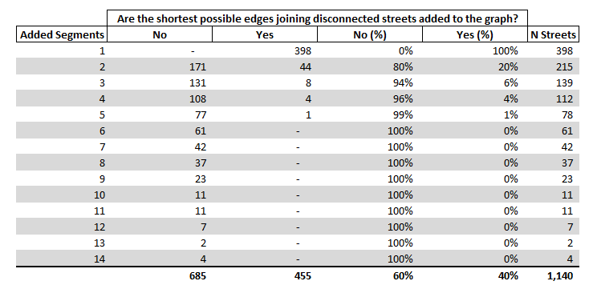
Why NetworkX is necessary:
NetworkX is optimizing connectivity across the entire network – not just a single segment.

Slide 11
5 Examples in qGIS
All added segments
Added segments by road type
The 10 longest added segments
Roads with at least 10 discontinuities
Unique roads are a combination of road name, type, direction

Slide 12
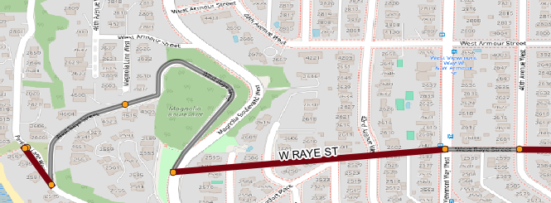
Strengths
Quick!
<10 minutes to import data, identify street discontinuities, and create segments
Deterministic
Easy to verify a single street…

Slide 13
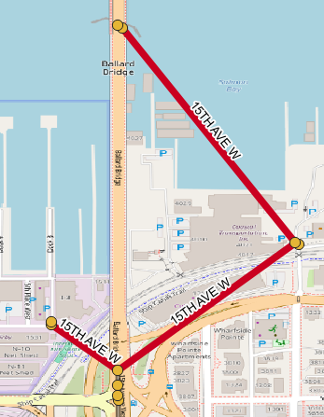
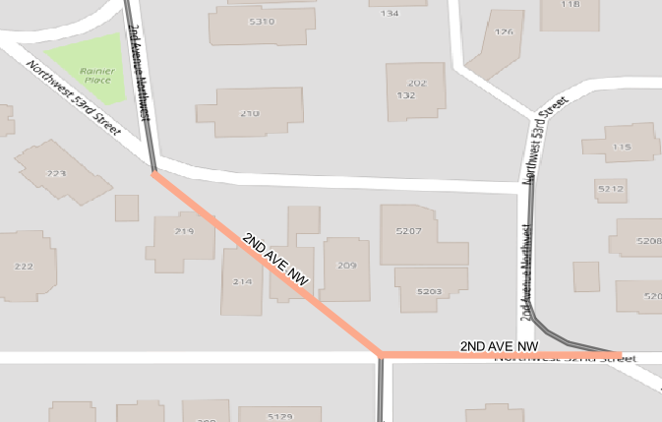
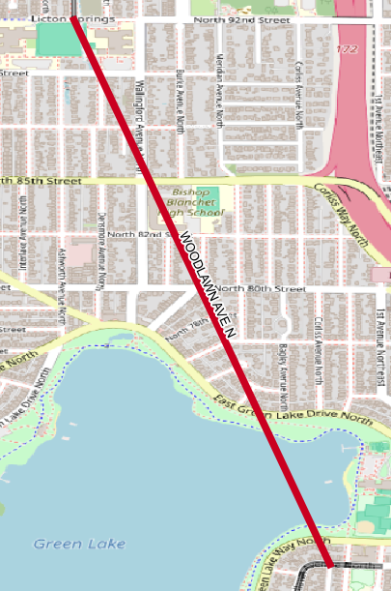
Limitations
Hard to verify ALL added streets
NetworkX finds the optimal path based on edge weight (shortest geographic distance), but not always the shortest
Odd data artifacts and errors in the source data create invalid added segments
OpenStreetMap, Google, and City of Seattle sometimes disagree
Sometimes the shortest distance between disconnected streets is not the street end.
nx.degree_centrality() could be used to further identify street ends

Slide 14
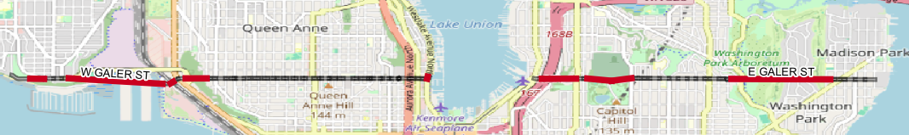
Next steps
Connect streets that span different city sections?
Connect W GALER ST to GALER ST to E GALER ST
Host on a webpage!
Use data from OpenStreetMap

